Slide 1

Medi-Span®
臨床決策再進化
飛資得醫學資訊－2018

Slide 2
Agenda
About Wolters Kluwer Health & Lexicomp
Drug Reference vs. Drug Data
Q&A
MediSpan Solution for Hospital System

Slide 3






Wolters Kluwer Health
已於荷蘭創立 175 年，如今 Wolters Kluwer 是全球知名且具領導地位的資訊服務與出版集團。
  業務範圍橫跨 40 多個國家，包含歐洲、北美洲、亞太以及拉丁美洲。
  服務超過一千三百萬名醫療照護人員
  總部位於荷蘭
  集團內品牌包含

Slide 4
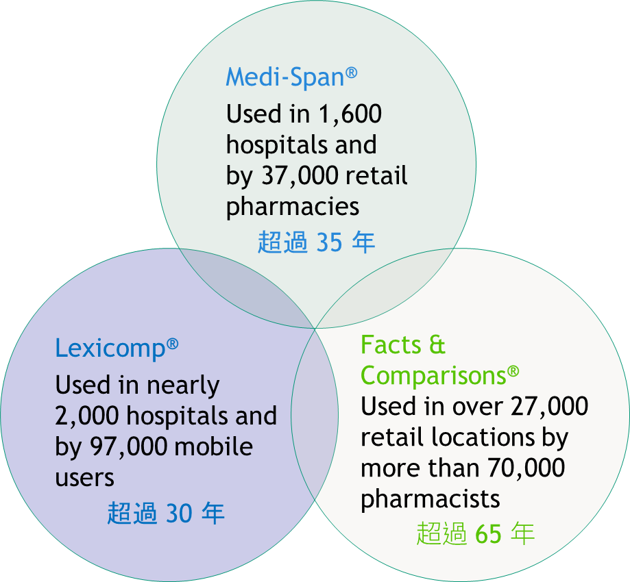
Wolters Kluwer Health － Clinical Solutions
全球多達兩百人的團隊 (醫、藥、護及資訊人員)
業界領先的參考資料及整合內容服務
跨平台跨領域的資訊服務及系統整合
  API
  HL7 InfoButton

Slide 5
飛資得醫學
飛資得企業集團成立超過 30 年
提供電子資源代理及資訊系統專案開發等業務
藥學領域相關資源與經驗
  Lexicomp 台灣獨家代理
  2005 – 2011 衛生署藥品交互作用資料庫系統
  北榮藥劑部 – 條碼輔助藥庫收貨系統、住院條碼輔助調劑系統

Slide 6
Agenda
About Wolters Kluwer Health & Lexicomp
Drug Reference vs. Drug Data
Q&A
MediSpan Solution for Hospital System

Slide 7



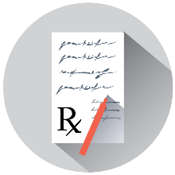





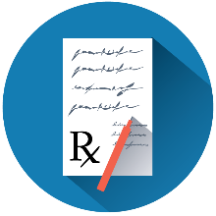



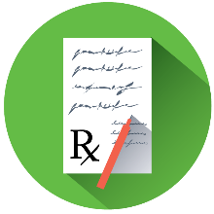


Reference vs. Data (Content)
Normal Workflow (No Clinical Reference Information Consulted):
Patient visits the Doctor
Doctor decides on a treatment
Doctor writes the prescriptions
Online Reference (Manual):
Patient visits the Doctor
Doctor decides on a treatment
Doctor thinks there may be a problem
Doctor stops to read textual references
Doctor writes the prescriptions
Embedded Data (Automatic Screening):
Patient visits the Doctor
Doctor decides on a treatment
Doctor writes the prescriptions
Embedded data in prescribing software checks for problems
Doctor is instantly alerted to issues
Notes:
Updated 7/11/16
[Basic]
Talking Points
The most important step you can take in reducing medication errors is to implement a medication decision support solution.
There are two components to a medication decision support solution: drug reference information and embedded drug data.
Normal Workflow:
In a normal clinical workflow, a patient visits a doctor, the doctor writes a prescription, and that’s it. There are no safety checks involved.
Online Reference:
Add in a drug information reference like a book or online reference and the physician is able – if he or she has questions or concerns about a prescription – to look up information on dosing, interactions, and more to help them make a safe decision.
Embedded Data:
With an embedded drug data solution in the hospital’s EHR, the doctor writes the prescription and data within the computer system automatically screens for potential medication errors, taking into account the patient’s profile and current medications. If there is a problem, the physician is instantly alerted.
While the addition of medication decision support references and data, the process of selecting and ordering a prescription does take a little longer, but ultimately is safer … as well as being more efficient and cost effective in the long run. By taking a little extra time to review a prescription with a drug reference or consider an embedded data alert, a doctor can avert potential prescription errors that otherwise could have resulted in harm to the patient and costly readmissions and corrective treatments.
Optional for Clarity
Online Reference
Reference content is human-readable drug information that can be searched, read and easily understood by a healthcare professional. When we refer to reference solutions, we are talking about the kind of detailed information you find in text books and primary literature, such as proper dosing of the drug, what it is used for, how to administer it, potential side effects, precautions, etc. Reference solutions provide detailed information on individual drugs and diseases and also give users the ability to look up general information. As an example, when a pharmacist needs to investigate further into why certain drugs should not be prescribed together due to interactions or other issues, they will be referring to information. They will take an active step to search for information and study it in more detail.
Embedded Data
Unlike reference which is a separate source of information, data solutions can be incorporated directly into your HIS/EMR so that they automatically become part of your existing workflows. We provide machine-readable drug data designed to be read and understood by computers and incorporated directly into your vendor applications, such as EHRs and practice management systems. Data solutions are designed to work behind the scenes to screen for patient-specific situations, such as drug interactions or allergies and user-based dosing instructions. Rather than having to open up a Web browser and search for information, the system will work out what information is relevant to you at the moment of order entry and will make that information available through alerts within your HIS/EMR system. In other words, data solutions work in conjunction with your hospital system to help define and avoid potential problems in advance.
The main purpose of drug data is to assist clinicians at the point of care. Data solutions are NOT intended to disrupt a clinician’s normal workflow or replace clinician judgment, but rather to provide a tool to assist care team members in making timely, informed, and higher quality decisions. When CDS is applied effectively, it increases quality of care, enhances health outcomes, helps to avoid errors and adverse events, improves efficiency, helps reduce costs, and can boost provider and patient satisfaction.

Slide 8
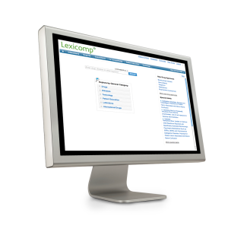
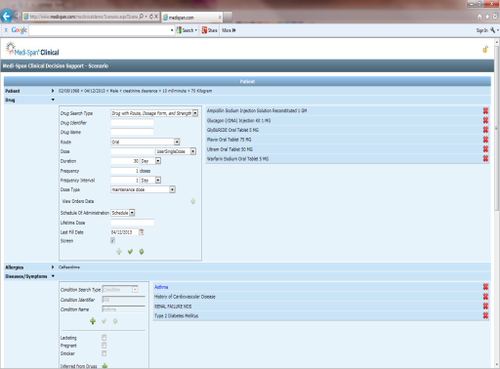
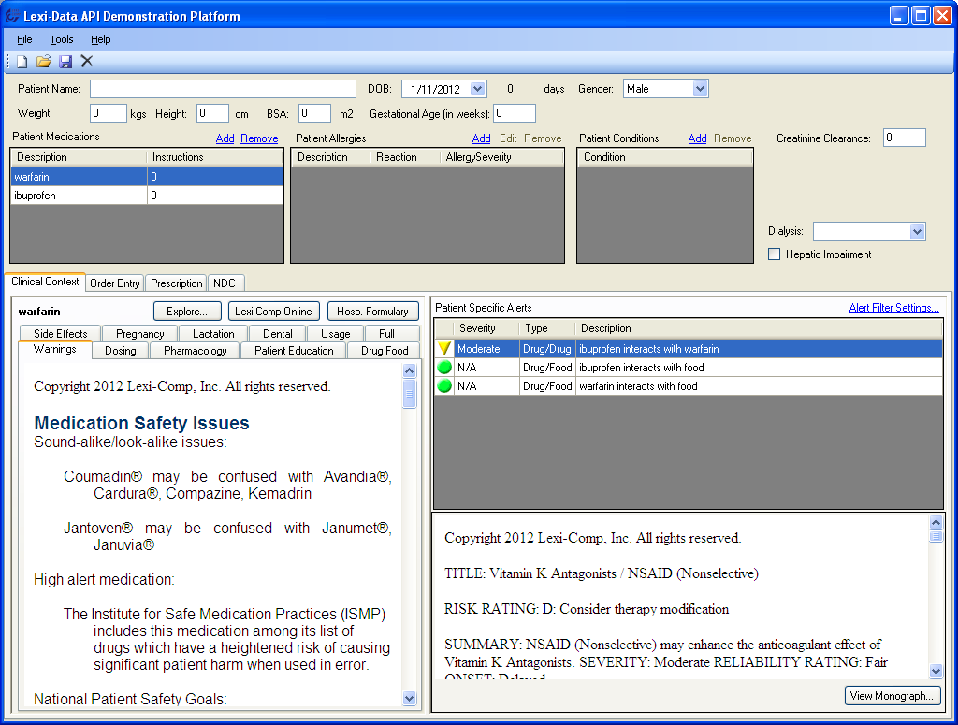
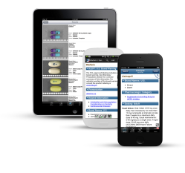
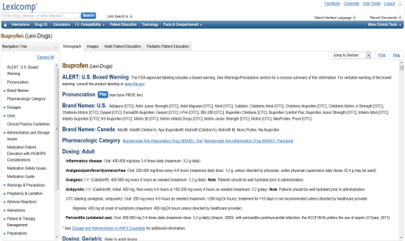
Online vs. Integrated vs. Embedded
Online (Reference)
Integrated (Reference)
Embedded (Data)
Lexicomp® Online™, Lexicomp Mobile Apps or Facts & Comparisons® eAnswers
Accessed directly through a Web browser or mobile application
Must use the search function to find information
Lexicomp® Online™ Integrated or Infobutton™
Same online product viewable as a window or popup inside the vendor application
Display formatting is controlled by the online product or application
Can jump directly to the required monograph (e.g., “More Info” button)
Medi-Span Clinical APIs
Granular data elements are extracted and displayed by the vendor application
Display formatting is controlled by the vendor
Information is concise and contextual (e.g., screening and alert popups)
Notes:
Updated 10/12/14
[Basic]

Slide 9
1.Online
Online (Reference)
Lexicomp® Online™, Lexicomp Mobile Apps or Facts & Comparisons® eAnswers
Accessed directly through a Web browser or mobile application
Must use the search function to find information
Notes:
Updated 10/12/14
[Basic]

Slide 10
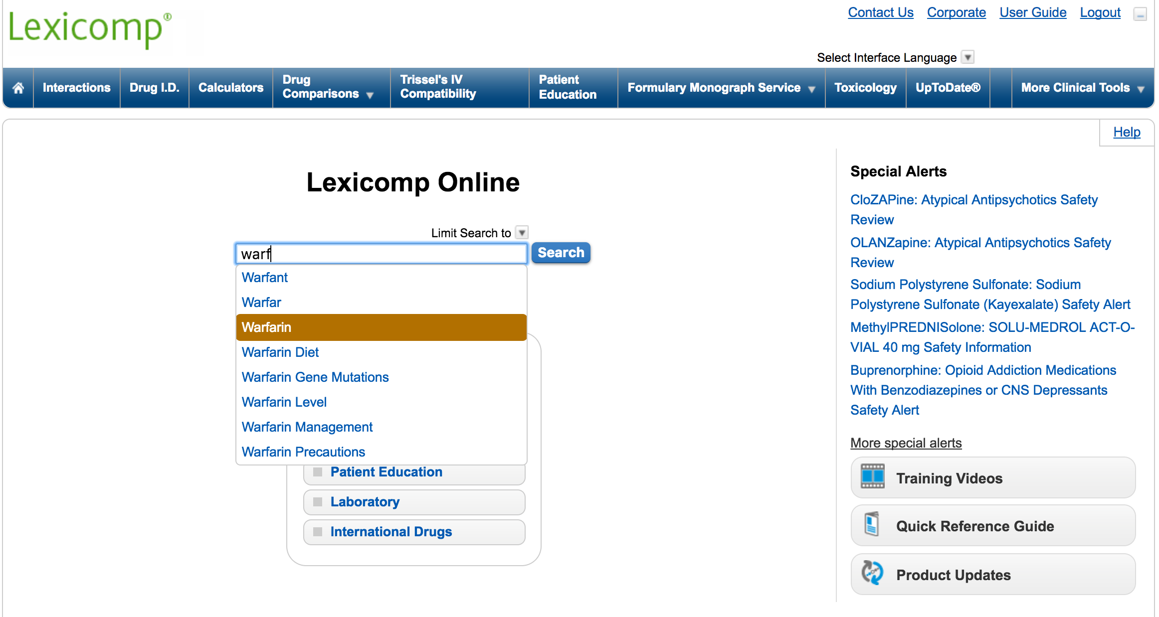
使用方式 – Online Reference

Slide 11
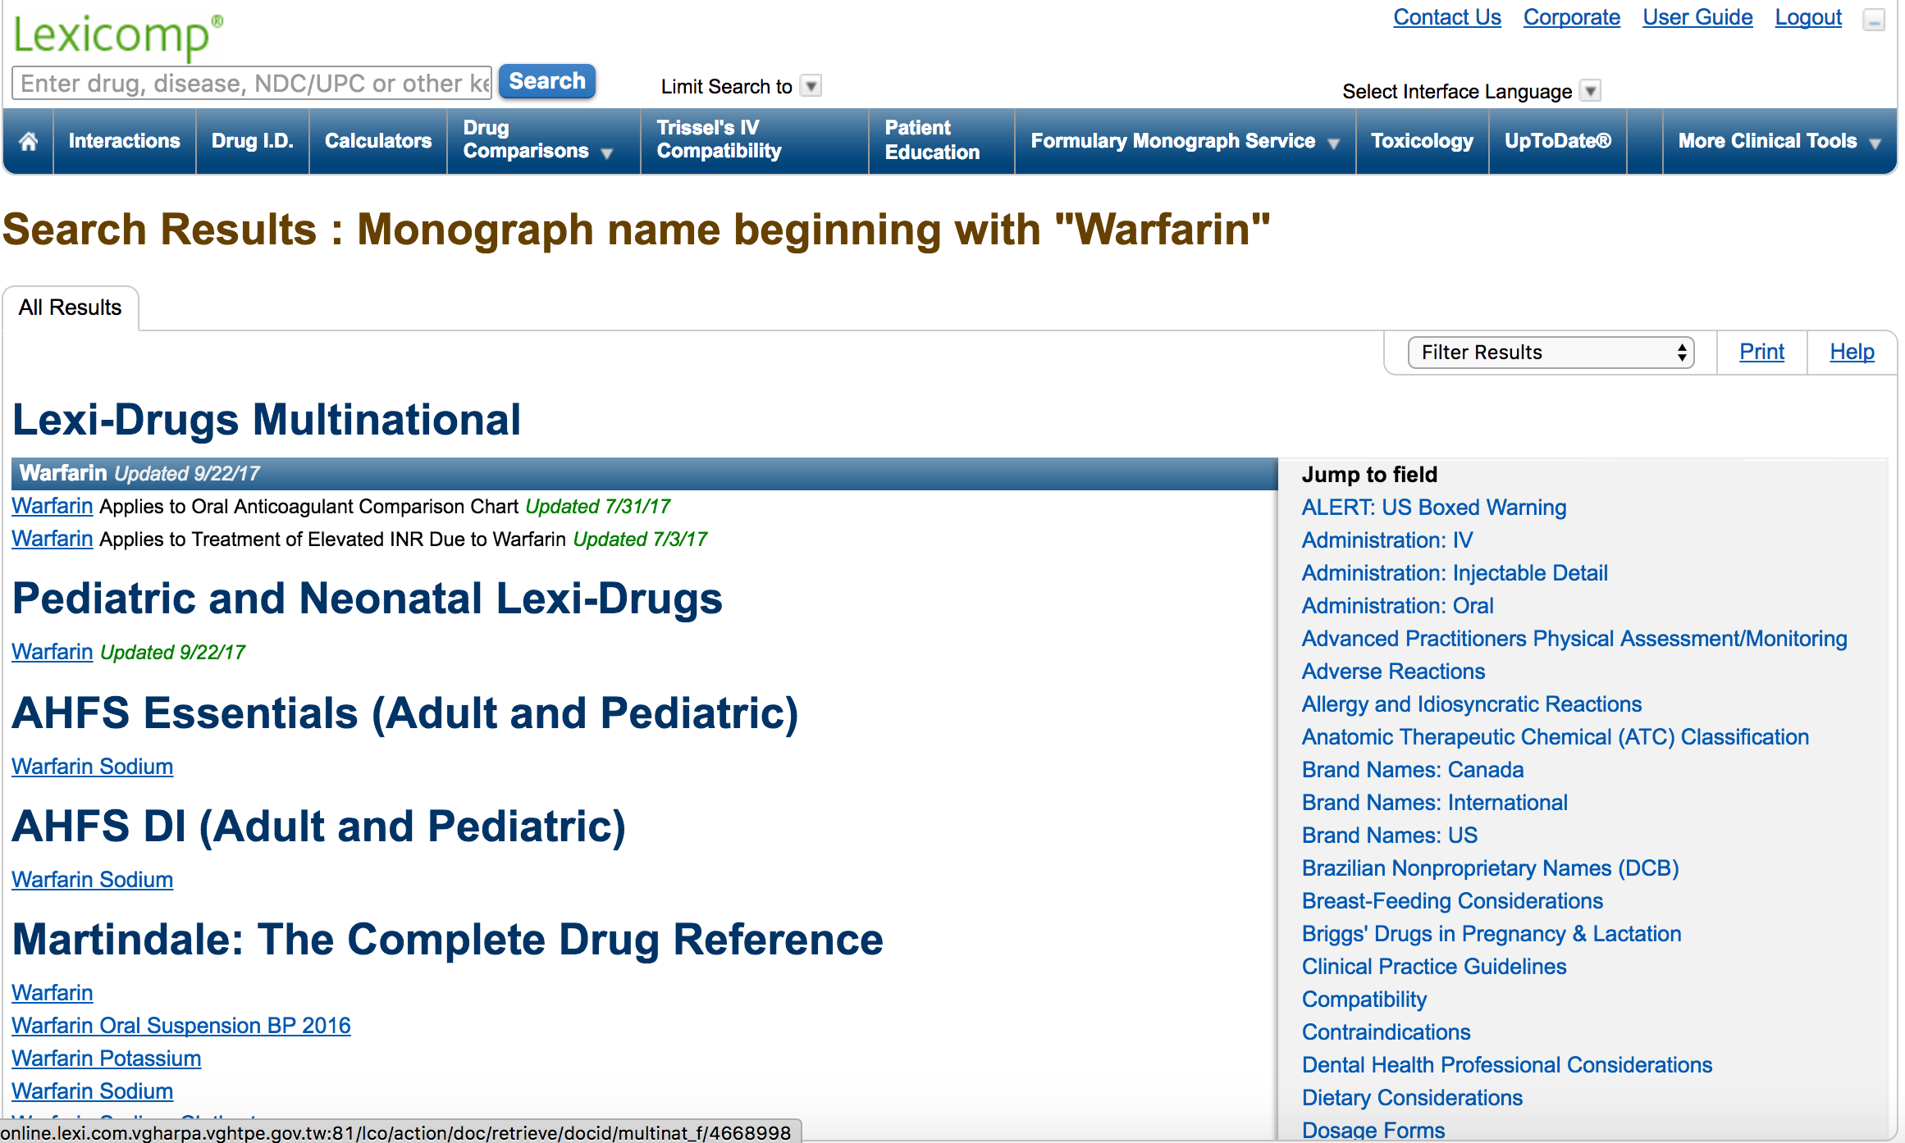
使用方式 – Online Reference

Slide 12
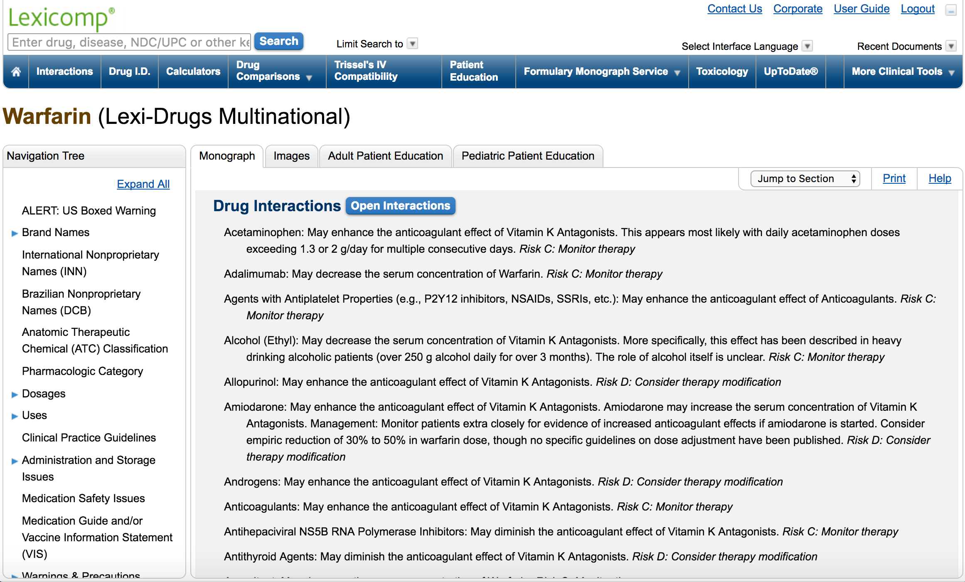
使用方式 – Online Reference

Slide 13
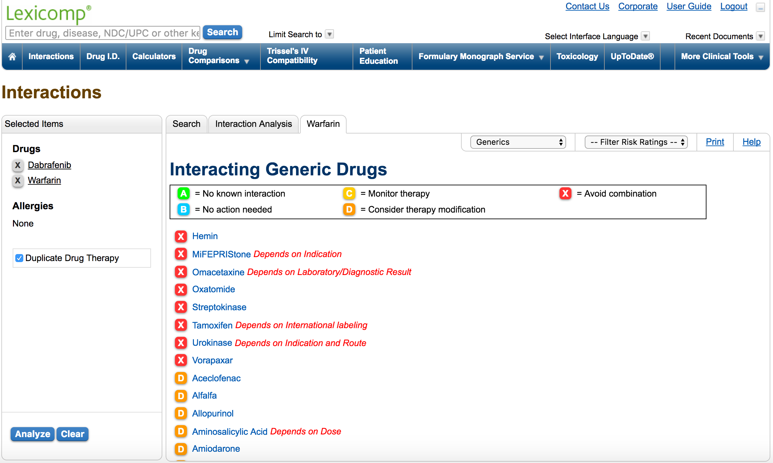
使用方式 – Online Reference

Slide 14
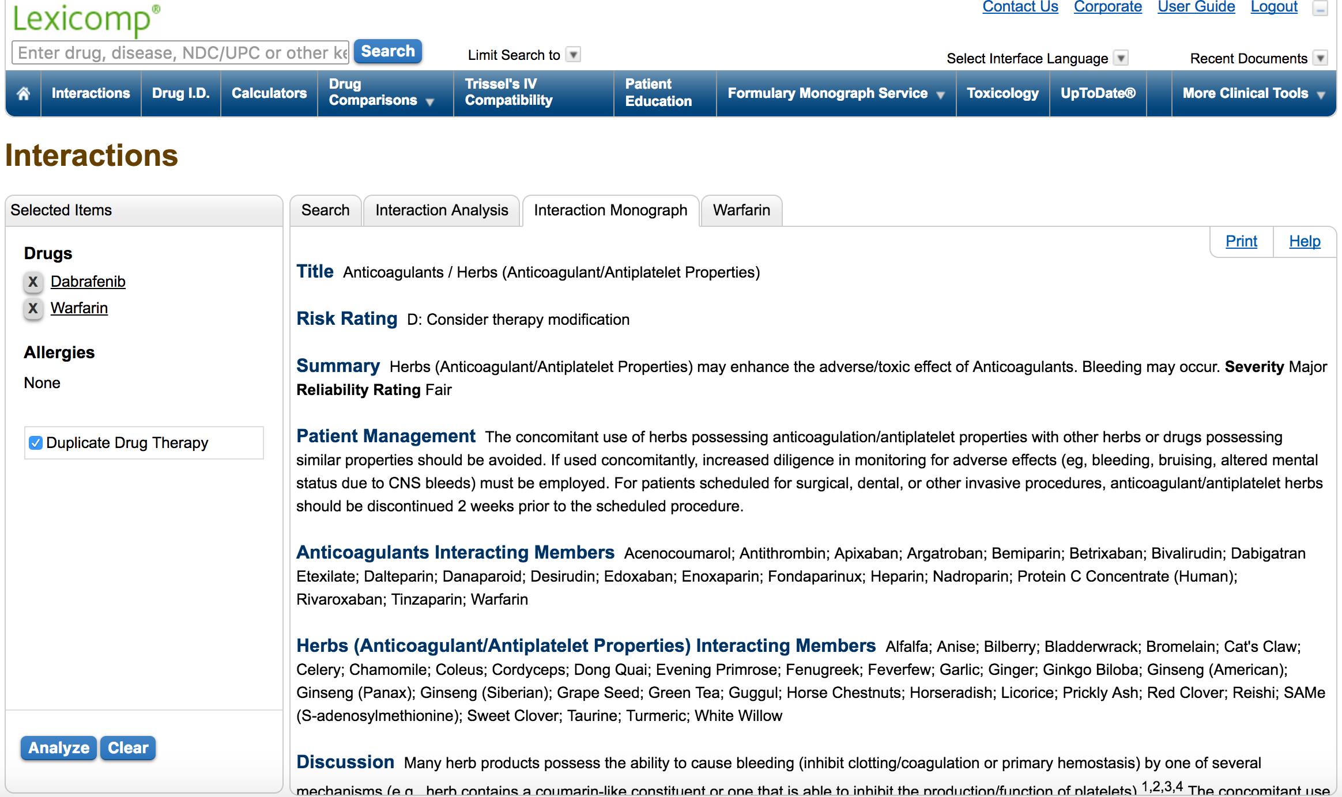
使用方式 – Online Reference

Slide 15
2.Integrated
Integrated (Reference)
Lexicomp® Online™ Integrated or Infobutton™
Same online product viewable as a window or popup inside the vendor application
Display formatting is controlled by the online product or application
Can jump directly to the required monograph (e.g., “More Info” button)
Notes:
Updated 10/12/14
[Basic]

Slide 16
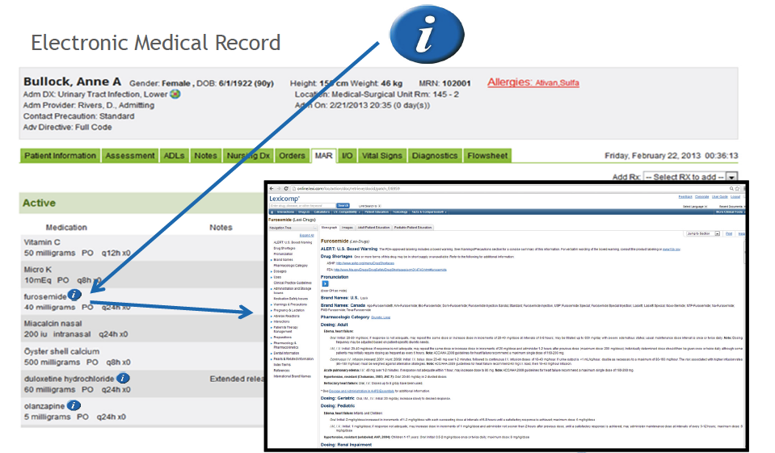
使用方式 – Integrated (Reference)

Slide 17
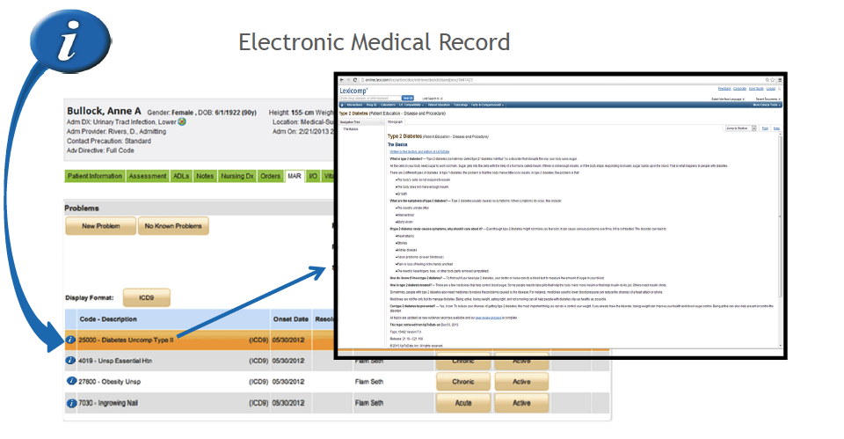
使用方式 – Integrated (Reference)

Slide 18
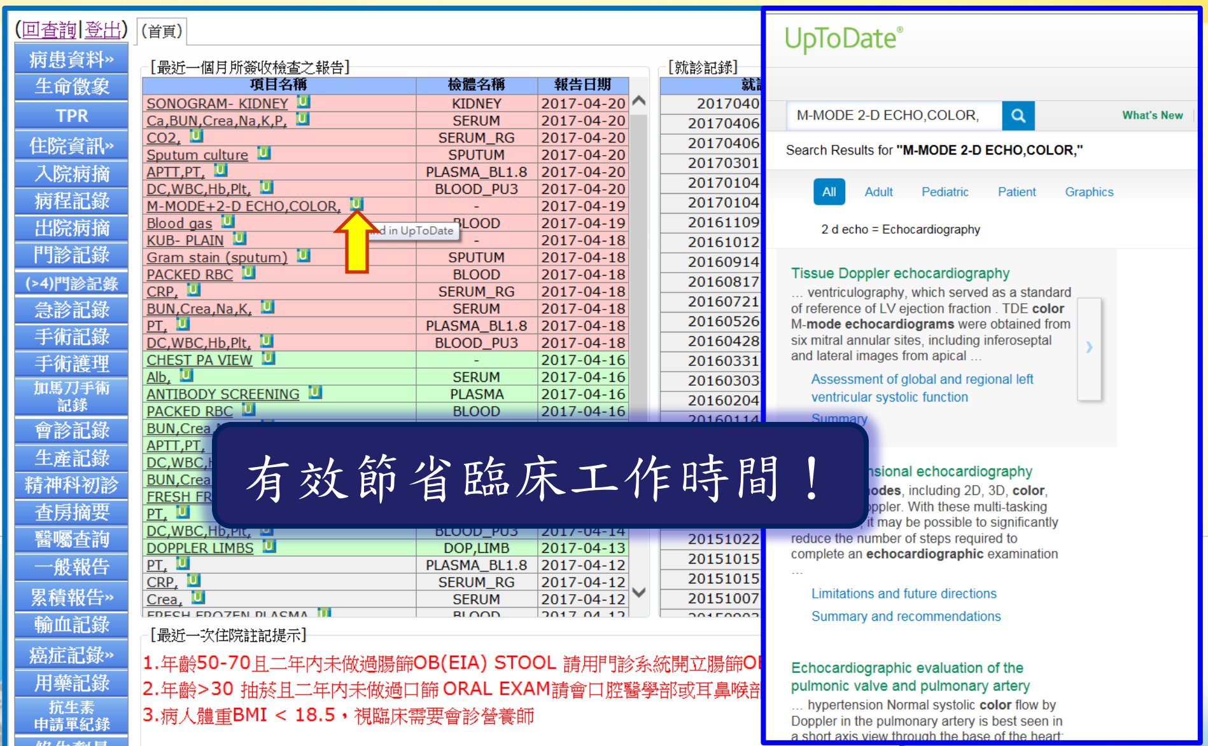
使用方式 – Integrated (Reference)

Slide 19
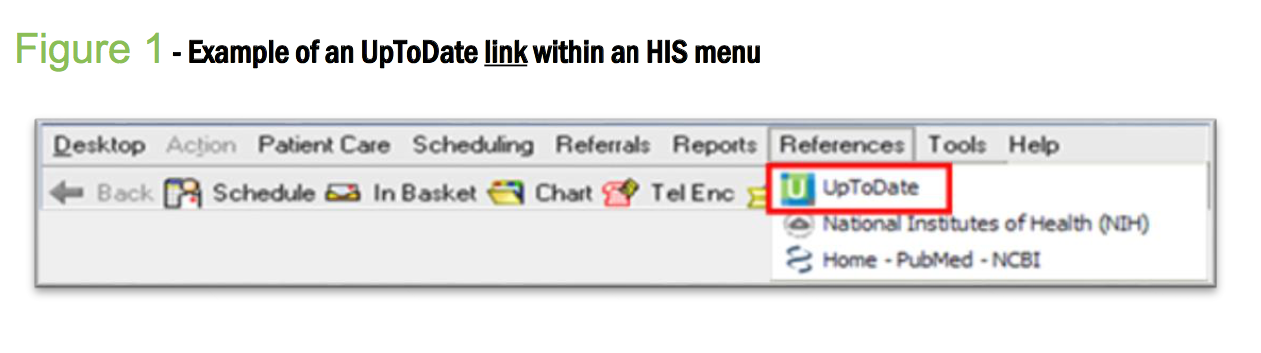
使用方式 – Integrated (Reference)

Slide 20
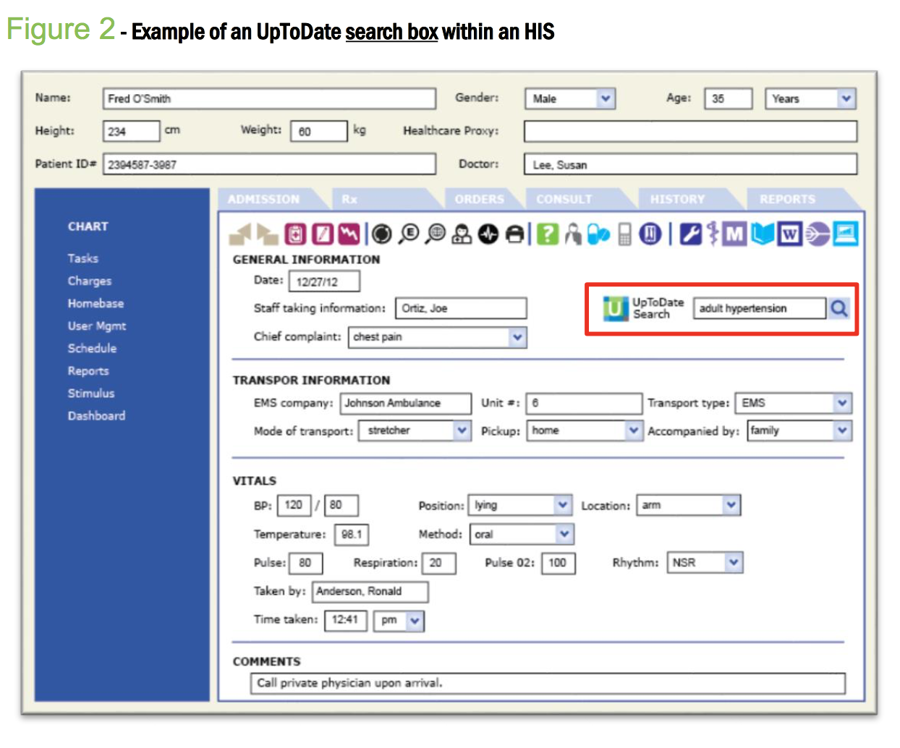
使用方式 – Integrated (Reference)

Slide 21
使用方式 – Integrated (Reference)

Slide 22
3.Embedded（Data）
Embedded (Data)
Medi-Span Clinical APIs
Granular data elements are extracted and displayed by the vendor application
Display formatting is controlled by the vendor
Information is concise and contextual (e.g., screening and alert popups)
Notes:
Updated 10/12/14
[Basic]

Slide 23
Web API Embed Sample

Slide 24
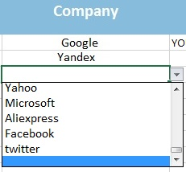




Order Entry Example - Inline
Sarah Kim (1000876)
Birth: 06/15/1983
Gender: F
Weight: 60kg
Creatinine Clearance:
50 ml/minute/1.73m2
Disease:
Parkinson’s Disease
Droper
Droperidol Inj 2.5mg/ml
Droperidol Tab 10mg
Digoxin Tab 250MCG
2 Tab
2 Time
1 Day
Overdosing / Daily Dose
The single dose of 2 tablets exceeds the maximum single dose of 1.5 tablets.
The daily dose of 4 tablets exceeds the usual dose of 0.25 to 1.5 tablets.
The frequency of 2 times per day exceeds the usual frequency of 2 times per 3 days to daily.
400 Mg
1 Time
1 Day
Acetaminophen Oral Tab 650mg
Alprazolam Tab 0.5mg
1 Mg
3 Time
1 Day
Gender Contraindication
Administration of Alprazolam Tab 0.5 MG should be used with extreme caution
in Child-Bearing Aged Female
10 mg
1 Time
1 Day
Metoclopramide HCI Inj 10MG
Disease Contraindication
Administration of Metoclopramide HCl Inj 10 MG/ML should be used with extreme
caution in Parkinson's Disease.
Notes:
Updated 17/2/17
[Basic]
Talking Points
In this example of an order entry screen, you can see the patient’s profile information on the left. On top, a drop-down picklist assists the physician in entering the drug order.
This particular example features in-line screening, an efficient feature that generates alert previews as you enter the medication order, so you know right away if there is potential conflict.
Here, we see a serious alert (in red) indicating the suggested digoxin dose is inappropriate. Two additional moderate alerts (in yellow) are also showing up.

Slide 25
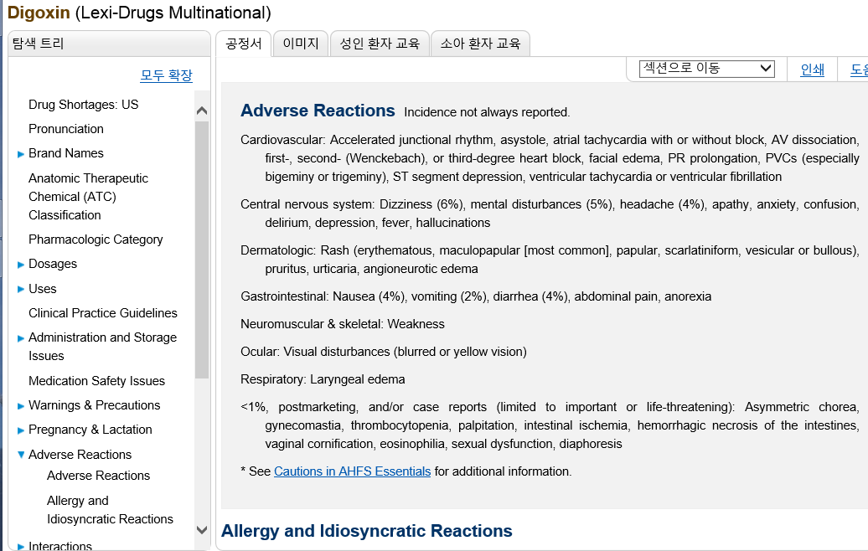
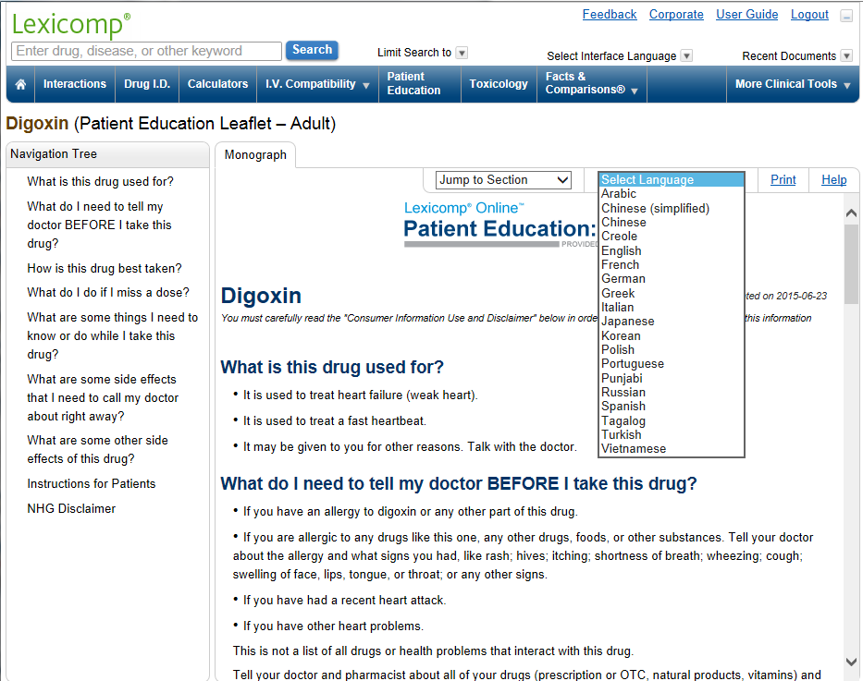
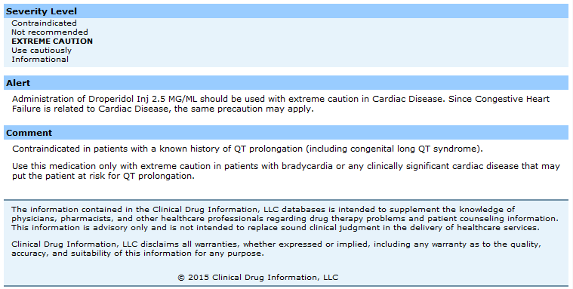

Order Entry Example - Inline
Sarah Kim (1000876)
Birth: 06/15/1983
Gender: F
Weight: 60kg
Creatinine Clearance:
50 ml/minute/1.73m2
Disease:
Parkinson’s Disease
Droper
Droperidol Inj 2.5mg/ml
Droperidol Tab 10mg
Digoxin Tab 250MCG
2 Tab
2 Time
1 Day
Overdosing / Daily Dose
The single dose of 2 tablets exceeds the maximum single dose of 1.5 tablets.
The daily dose of 4 tablets exceeds the usual dose of 0.25 to 1.5 tablets.
The frequency of 2 times per day exceeds the usual frequency of 2 times per 3 days to daily.
Inferred Disease Screening
Administration of Droperidol Inj 2.5mg/ml should be used with extreme caution in Cardiac Disease. Since Congestive Heart Failure is related to Cardiac Disease, the same precaution may apply.
400 Mg
1 Time
1 Day
Acetaminophen Oral Tab 650mg
Alprazolam Tab 0.5mg
1 Mg
3 Time
1 Day
Gender Contraindication
Administration of Alprazolam Tab 0.5 MG should be used with extreme caution
in Child-Bearing Aged Female
10 mg
1 Time
1 Day
Metoclopramide HCI Inj 10MG
Disease Contraindication
Administration of Metoclopramide HCl Inj 10 MG/ML should be used with extreme
caution in Parkinson's Disease.
Notes:
Updated 17/2/17
[Basic]
Talking Points
If you need more information about an alert, one option is to include HL7 Infobutton links. Subscribers to Lexicomp Online can click on the blue button and jump directly to the Lexicomp drug reference monograph for the listed medication. Clicking on the mortar and pestle icon takes you directly to the patient education leaflet for the medication.

Slide 26
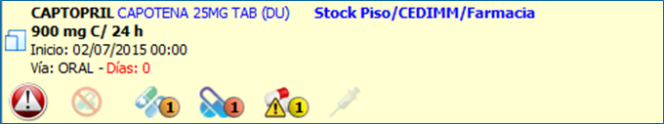
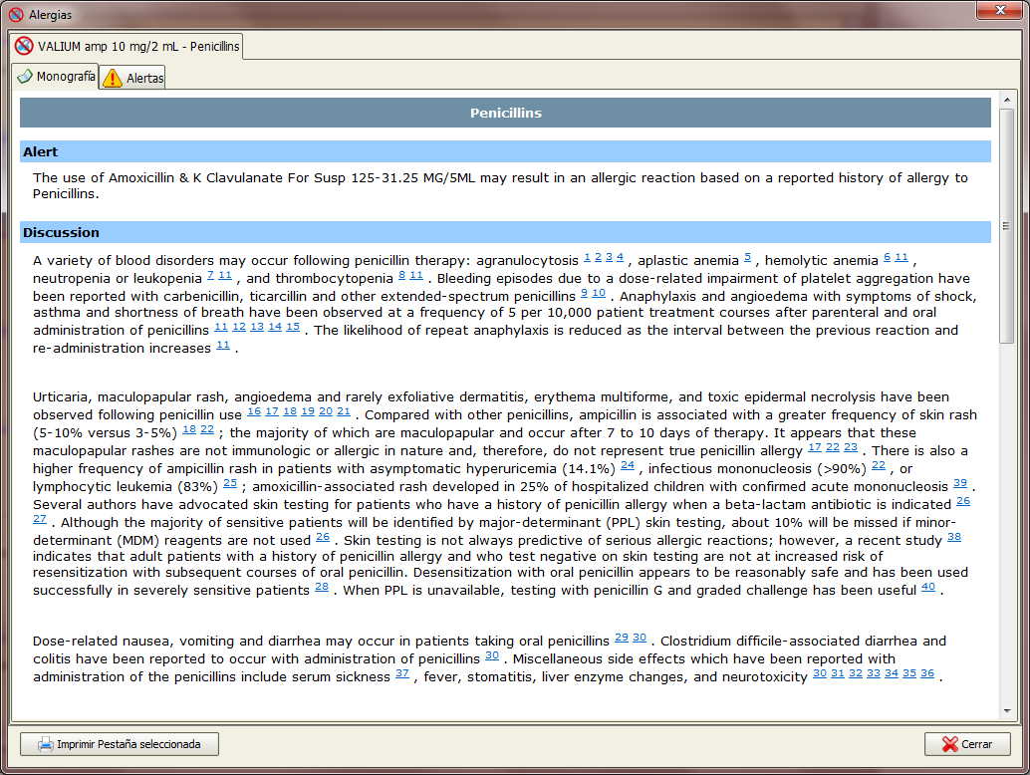

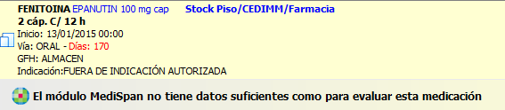
Order Entry Example - Icons
Notes:
Updated 26/8/15
[Basic]

Slide 27
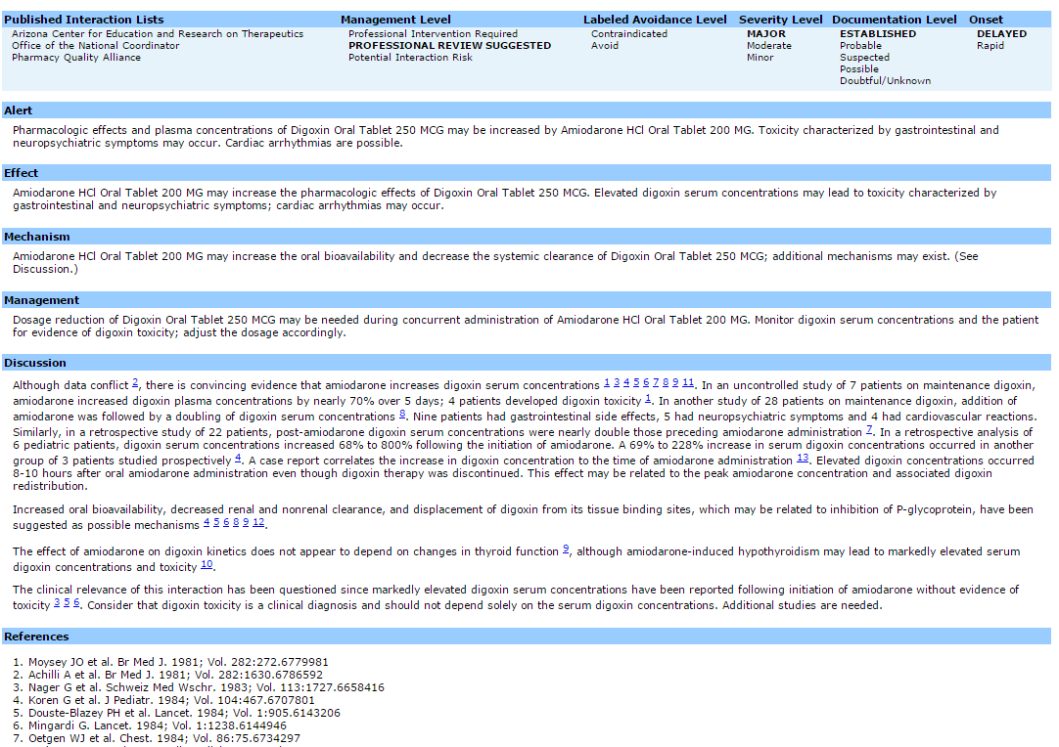

Pharmacy Review Example
Medication Management System
Interaction AMIO DIGX - MAJOR
Amiodarone HCI Oral Tablet 200 MG
Digoxin Tablet 250 MCG (0.5 MG)
Pharmacologic effects and plasma concentrations of Digoxin Tab 250 MCG (0.25 MG) may be increased by Amiodarone HCI Oral Tablet 200 MG. Toxicity characterized by gastrointestinal and neuropsychiatric symptoms may occur. Cardiac arrhythmias are possible
INT ALG DOS DUP RCI DCI PCI
1Clinic John 10001 AMIO 1 1 1
1Clinic John 10001 DIGX 1 1 1
1Clinic John 10002 WARF 1 1 1
3Clinic Tom 10004 PENC 1 1 1
Notes:
Added 21/7/15
[Basic]

Slide 28
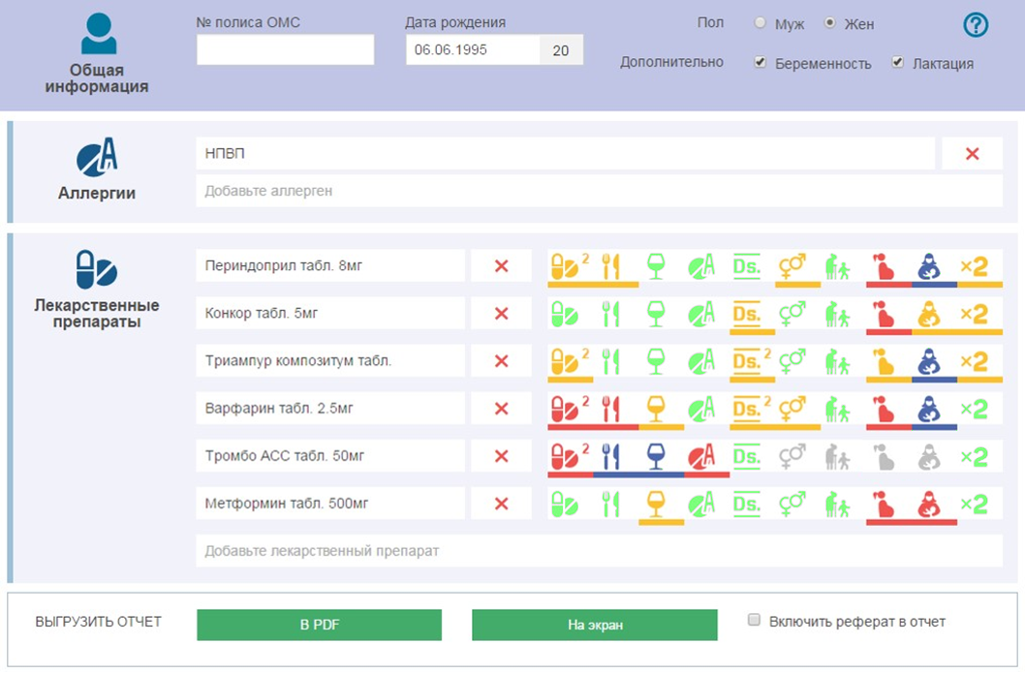
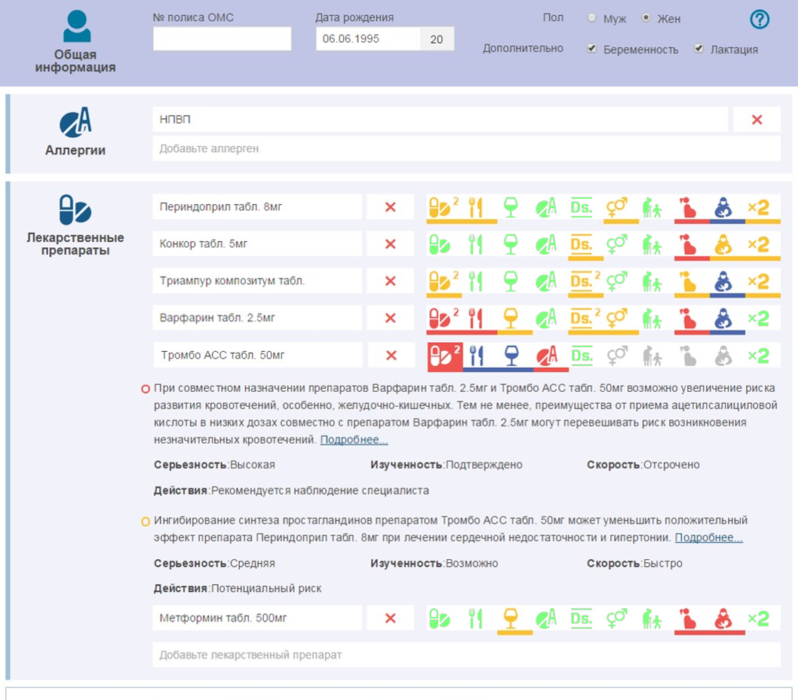
Alert Example – Icons with Expander
Notes:
Updated 17/11/15

Slide 29
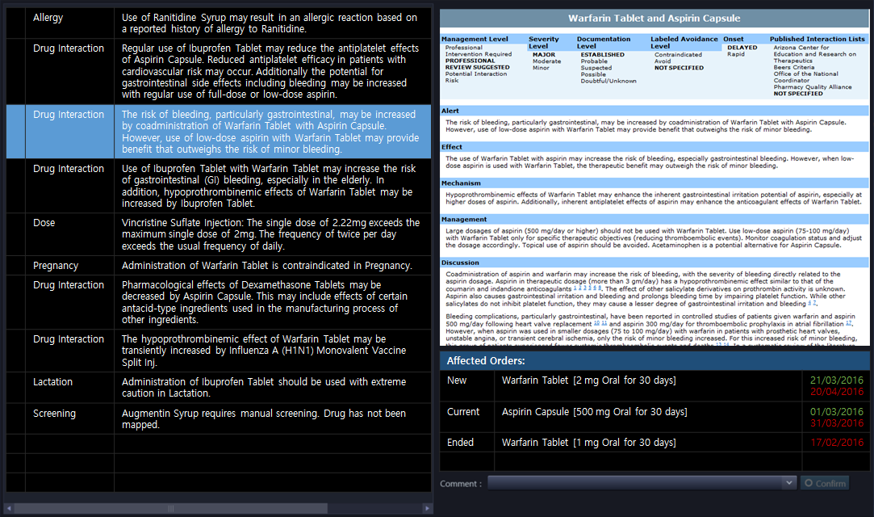







Alert Example – Override Confirmation
Notes:
Added 31/7/17

Slide 30
Agenda
About Wolters Kluwer Health & Lexicomp
Drug Reference vs. Drug Data
Q&A
MediSpan Solution for Hospital System

Slide 31
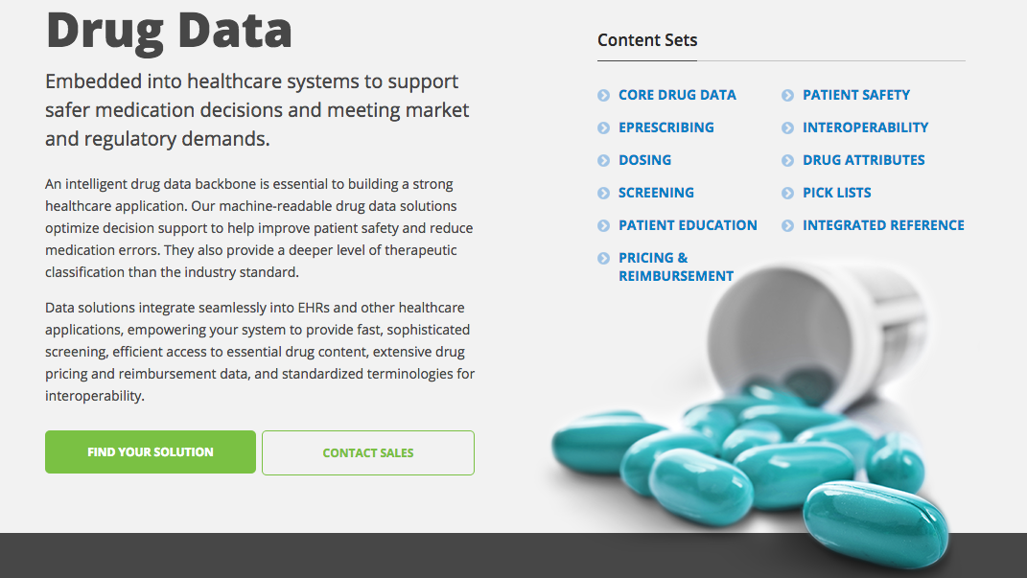
Lexicomp® and Medi-Span® Clinical

Slide 32
Medi-Span臨床決策服務內容
藥物比對服務：將您機構的藥品清單對應至資料庫的藥品內容、編碼以及正規化
持續更新比對服務：持續在藥品推出時不斷更新比對內容
臨床決策支援模組：選用所使用到的模組
技術整合與導入協助
顧問暨諮詢服務

Slide 33

Medi-Span臨床決策服務帶來的好處
全球化支援
減少警示雜訊以及疲勞
提升處理速度
減少整合時所需要的資源
減少資料維護以及更新作業
允許快速適應不斷變化的需求
促進協同作業能力

Slide 34
Lexicomp整合至醫院工作流程
Patient demographics and history entered into workflow.
Physician researches drug information.
Physician orders medication, prompting drug screening.
Physician evaluates physician-level alerts and determines a treatment plan.
Drug order is received by the pharmacist, who evaluates any pharmacy-level alerts.
Pharmacist researches alternative therapy options and dispenses appropriate therapy.
Nurse reviews the medication order, records administrations on the eMAR, and evaluates any nurse-level alerts.
Nurse researches drug information questions.
Nurse distributes patient education leaflets.
Verify treatment dose
Check contraindications, warnings, & adverse events
Reference recent literature/CPGs
Allergies & conditions
Age, weight, & gender
Allergies
Dose Ranges
Duplicate Therapy
And more!
Formulary status
Drug shortages
And more!
I.V. compatibility
And more!
Preparation & storage
Administration
Monitoring parameters
Medication
Condition & Disease
Procedure & Diagnostics
Healthy Living
Interactions
And more!
Screening stat drugs
PRN daily dose checking
And more!
And more!
Reference
Data
Reference
(Lexicomp Online)
Data
Reference
Data
(Medi-Span Clinical)
Reference
Data
Notes:
Updated 9/12/14

Slide 35
Screening Workflow Options
Start New Order for Patient
Enter Diagnosis
Search New Drug
Select Drug
Enter Dosing Instructions
Add Drug To Order
Finalise Order
Repeat for all drugs to be ordered
Bad Screening Workflow
Screen all drugs, allergies, and conditions and show all alerts at once
Good Screening Workflow
Screen new drug for interactions, allergies, duplicate therapy, and contraindications and show alerts
Screen new drug for dosing and route contraindications and show alerts
Confirm alert overrides
Best Screening Workflow
Screen new conditions against current medications and show alerts
Screen all drugs in search results and show icons or colours indicating drugs that would cause alerts
Show alerts for new drug
Screen individual dosing elements as user is typing and show icons or warnings next to or below input boxes
Confirm alert overrides
Notes:
Updated 17/11/15
[Basic]

Slide 36
Medi-Span Clinical API Modules
Hospital System
Generic Product Identifier (GPI)
Medi-Span Clinical API
Core Vocabulary
Patient Profile (Patient Age/Weight, Medication History, New Orders,
Conditions List, etc.)
Drug Concepts
Medical Conditions
Medical Conditions Concepts
Inter-operability Vocabulary
IV Compatibility API
Drug Allergy API
Patient Information
Disease Terminology Mappings (ICD-10, SNOMED)
Drug Disease Contraindications API
Drug Interactions API
Pregnancy, Lactation, Age & Gender API
Route Contraindications API
Dose Screening & Drug Order API
Integrated Patient Education API
Duplicate Therapy API
Adverse Drug Effects API
Clinical Modules
Indications API
Notes:
Updated 12/5/16

Slide 37


Wolters Kluwer Solutions
Online Reference
Wolters Kluwer
Internet
WK Online Reference Databases
Instant Updates
Professional Drug Information
Patient Education Leaflets
Etc.
WK Data Databases
Integrated Reference
Embedded Data
Professional Drug Information
Patient Education Leaflets
Etc.
Hospital System
Internet
HIS / EMR Application Server
HIS / EMR Database
Monthly Updates
HIS / EMR Application
Ordering
Dispensing
Etc.
Drug Interactions
Allergies
Dose Range Checks
Etc.
WK API
Local WK Database
LAN
Notes:
Updated 25/11/15
[Basic]

Slide 38
系統可對應的編碼
疾病編碼
藥品編碼
ICD-9-CM
ICD-10-CM and ICD-10-PCS
ICD-10-CA
SNOMED CT
Medi-Span Disease Codes
過敏編碼
RxNorm
FDA UNII
RxNorm
CVX
MVX

Slide 39
Drug Data Identifiers
GPI = Generic Product Identifier
  Active Ingredients + Route + Form + Strength
  Used for patient drugs
  MediSpan.Concepts.TherapeuticClassification.GenericProduct.GPI
KDC-5 = Knowledgebase Drug Code
  Active Base Ingredients
  Used for patient allergies
  MediSpan.Concepts.Ingredients.ScreenableIngredient.MediSpanId
PAR Class = Prior Adverse Reaction Class
  Allergen Class
  Used for patient allergies
  MediSpan.AllergicReactions.AllergenClass.MediSpanId
Global ID
  Active Ingredient [+ Route / Demographic]
  Used for accessing drug monographs
  Lexicomp Web API or Web Services
GDDID = Global Drug Database Identifier
  Represents any concept in the Global Drug Database
Notes:
Updated 6/5/15
[Basic]

Slide 40
Generic Product Identifier (GPI)
Represents Active Ingredients + [Route] + Form + Strengths
  E.g., Amoxicillin & K Clavulanate Tab 250-125 MG
Primarily used as the drug inputs for screening
Also exists as part of the Medi-Span proprietary Therapeutic Classification System (TCS) hierarchy
GPI is an alpha-numeric structured identifier
TCS / GPI Code | Type | Size | Representation | Example
01 |  | 0 | Drug Category | Anti-Infective Agents
12-xx-xx-xx-xx-xx-xx | 1 | 2 | Drug Group | *ANTIVIRALS*
12-10-xx-xx-xx-xx-xx | 2 | 4 | Drug Classification | *Antiretrovirals**
12-10-45-xx-xx-xx-xx | 3 | 6 | Drug Subclassification | *Antiretrovirals – Protease Inhibitors***
12-10-45-30-xx-xx-xx |  | 8 | Drug Base Name | Indinavir
12-10-45-30-20-xx-xx | 4 | 10 | Drug Name Extension | Indinavir Sulfate
12-10-45-30-20-01-xx |  | 12 | Dose Form Drug | Indinavir Sulfate Capsule
12-10-45-30-20-01-20 | 5 | 14 | Generic Product | Indinavir Sulfate Cap 200 MG
Notes:
Updated 18/5/14
[Basic]

Slide 41
Web API Embed Sample

Slide 42
Q&A
We are here because of you!

